Slide 1
Positive Behaviour Supports
Crisis Management

Slide 2

Activity

Slide 3

BC Report (2013)
What surprised you about this report?
What recommendations does this report suggest?
What is one action you can take as an EA now that you know about the impact of restraints and seclusion?

Slide 4
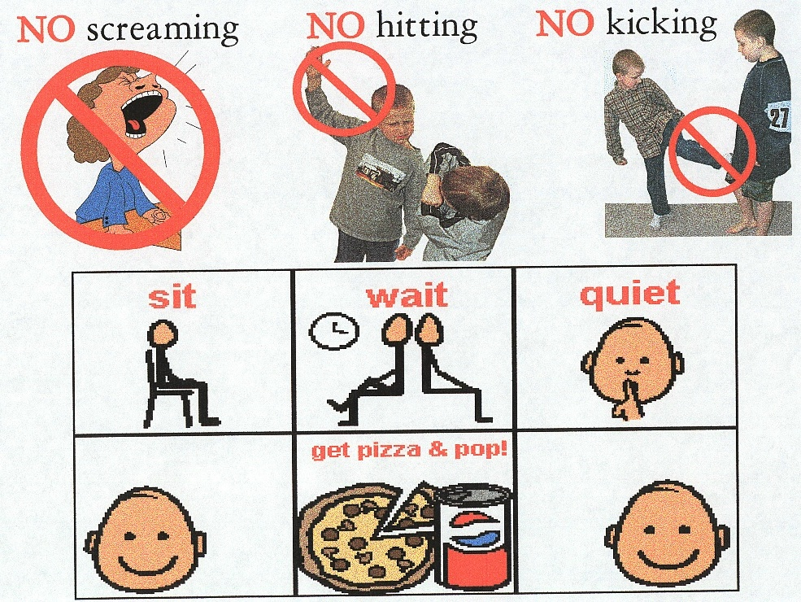
Reactive Strategies
Refers to what strategies will be used if the challenging behaviour occurs
Responses for early to late stages need to be determined when developing the support plan

Slide 5

Reactive Strategies
Prompt to the replacement behaviour (only if student is in a space to hear/respond to such requests)
Utilize authorized, approved procedures (maintain everyone’s safety)
Re-establish rapport after the behaviours is over
Involve additional personnel to develop other steps

Slide 6
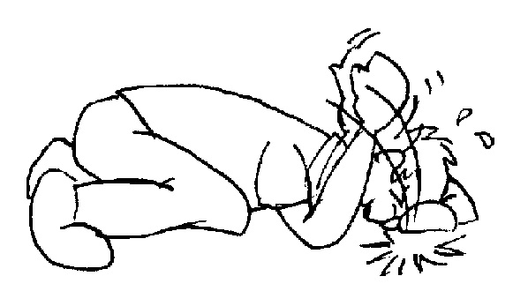
Reactive Strategies
Managing the Problem Safely
District Policies
Safety Plans
CPI or Mandt
Debriefing with student and for staff
Documentation
Future planning
Communication with parents/guardians

Slide 7

Pair - Share
What are the top 10 tips an EA needs to consider when supporting a student with challenging behaviour?

